Slide 1
Solacam
Making games for all the girls who play them.

Slide 2
How we started this project
While attending the Girls Who Code summer immersion program all of us expressed an interest in a final project that educated people on Health and Ableism. So we came together as a group and began the idea for a game called “A Day in the Life” that demonstrated the challenges of a person named Jaq who, like we all do sometimes, has trouble expressing how they feel. After designing “A Day in the Life” we decided we’d like to continue Solacam especially after realizing the lack of female video game designers and programmers. We intend to continue making video games that educate others on societal issues all while doing our best to close the gender gap in the STEM fields and the gaming industry.

Slide 3
Why BBG should invest
Built By Girls is a large competition with many applicants and while thinking of an idea we thought about what we’d like to see companies represent and what issues we felt needed to be addressed. Therefore we discussed many causes and issues we as Solacam want to fix. The main issues we are currently looking at are ableism and the gender gap. Both are issues that many people see but don’t necessarily acknowledge as a huge societal issue. While the gender gap is more frequently discussed it’s often discredited and said that in today’s world it “does not exist”. However it’s extremely discouraging to see that in the gaming world when you search “top female game programmers” or “top female game designers” the top ten lists you’re brought to do not contain any females. Ableism is something that we decided to work on because it is something we’ve all seen or dealt with. While the gender gap is being discussed Ableism is not being mentioned. Just this year Japan’s biggest mass killing since World War II was an attack on a facility for disabled people. Despite our best efforts we still found it hard to make a game that truly discusses ableism due to time constraint and a lack of previous knowledge about video game design and programming. However given more time and resources we’d most definitely pursue making a more all around game that discusses challenges presented by society.

Slide 4
Why Us
Why us was one of the hardest questions to answer at the beginning of this application. We had no specific goals in mind and all we really had to go on was the fact that we wanted to make a video game. However as we worked on the game more and more ideas arose for other games and other content we’d like. Including a website, more options in game and maybe even a few more games about different issues we all felt strongly about. So we figure the answer to why us is very simple. We want to close the gender gap, we want to educate others and to have ideas heard and spread. We want to make a change, one game a time.

Slide 5
Challenges while making “A day in the life”- Pt 1(RenPy)
When we first grouped together we knew that we wanted to make a video game, but we didn’t really know how to make it, or what to make it with. We kind of wanted to make an rpg type game(a game that looks pixel-like). It’s most used in games that has simple but straightforward graphics. Then we had another issue: we didn’t know what coding program to make it with. We couldn't use this popular program we thought we were going to use at first, called rpg maker, because we had to buy it and it was too expensive. So we googled programs and found one called RenPy. It’s similar to the program called Python; a coding language we’ve learned the basics of during Girls Who Code so that was a real bonus. Except it wasn’t used to make rpg-type games, it was used for making visual novels. Visual novels are games that require mainly reading and in certain parts of the story, you can make choices for a character. This is the program we decided to make the game with.

Slide 6
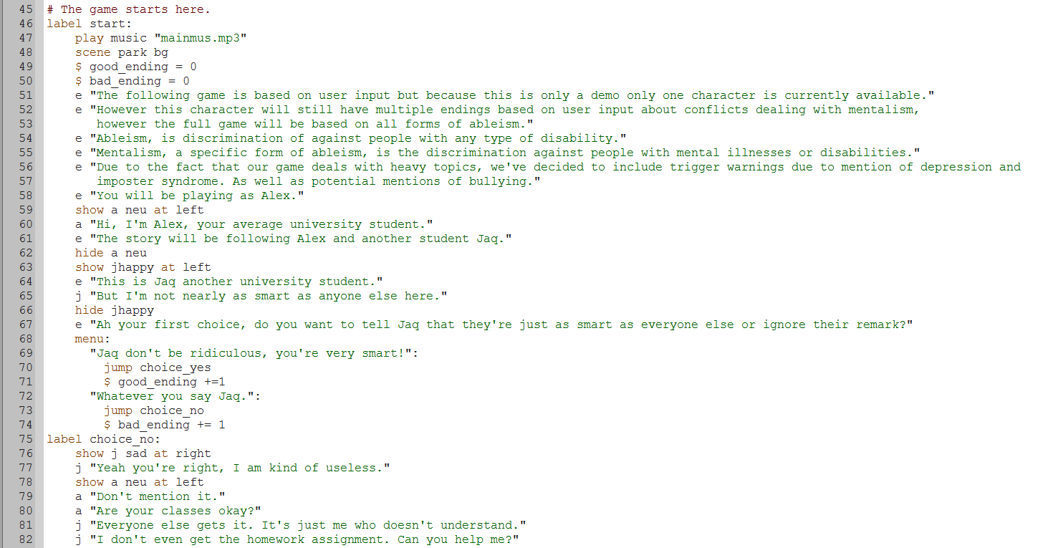

Slide 7
Challenges while making “A day in the life”- Pt 2(Making the game)
To make the game we had to make character sprites, get backgrounds, music, write the story, and code the players options so they can make choices to progress the story. We made the sprites using a website that lets you customise a character, called Rinmaru Games. We got the music from a non-copyrighted game music video from youtube. And we wrote the story along with the code using our own imagination and coding knowledge. When testing the game out, it sometimes stopped unexpectedly and we had to figure out why by checking the code. Usually it was just a syntax error (those happen a lot unfortunately!).

Slide 8
Next Steps...
Pitching our game, “A Day In The Life”, at the Girls Who Code graduation.
Keep in touch to figure out how we want to continue to make the game better including more characters and more options
Meetup to work on the game design and programing
Continuing to maintain and update a Solacam website
Discuss a new game and a new game style

Slide 9
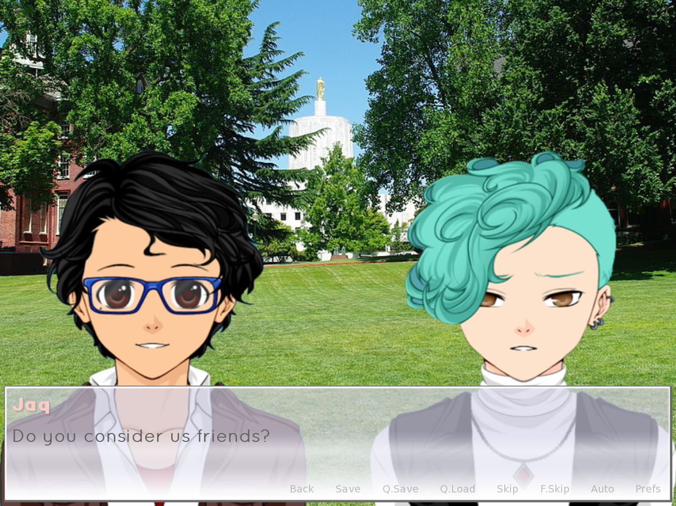

Slide 10
